Slide 1

WELCOME
TO
SMARTBRIDGE

Slide 2



ANALYSING HOUSING PRICES IN METROPOLITAN AREAS OF INDIA
BSC PHYSICS
TEAM CANDIDATE MEMBERS:1) AARTHI.S 2)ABINASH.M 3)BOOPATHY.V 4)SANJAY.B
UNDER THE GUIDANCE OF:
DR.P.RAMESH,M.SC,B.ED.,M.PHIL.,PH.D.,
Guest Lecturer UG and PG & Research
Department Of physics
GOVERNMENT THIRUMAGAL MILLS COLLEGE
GUDIYATTAM.632602

Slide 3
CONTENT OF THE THESIS
INTRODUCTION
PROBLEM DEFINITION & DESIGN THINKING
RESULT
ADVANTAGES & DISADVANTAGES
APPLICATIONS
CONCLUSION
FUTURE SCOPE

Slide 4
INTRODUCTION
1.1 OVERVIEW
House price prediction in a metropolitan city in India is a valuable solution for potential home buyers, real estate agents, and investors. By leveraging historical sales data, property details , and location- specific information , a predictive model can accurately estimate house prices.
1.2 PURPOSE
The model’s scalability, real–time updates , user- friendly interface, and transparency ensure it meets the needs of stake holders . Integration capability , data privacy , and cost effectiveness are also important considerations . By addressing these requirements , the prediction model provides reliable insights , empowering stakeholders to make informed decisions in the fast –paced real estate market.

Slide 5
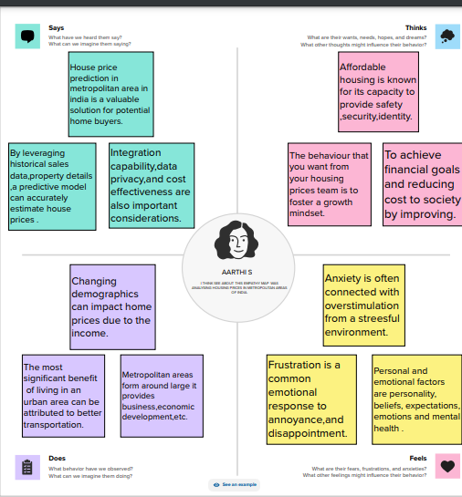
PROBLEM DEFINITION &DESIGN THINKING
2.1 EMPATHY MAP

Slide 6
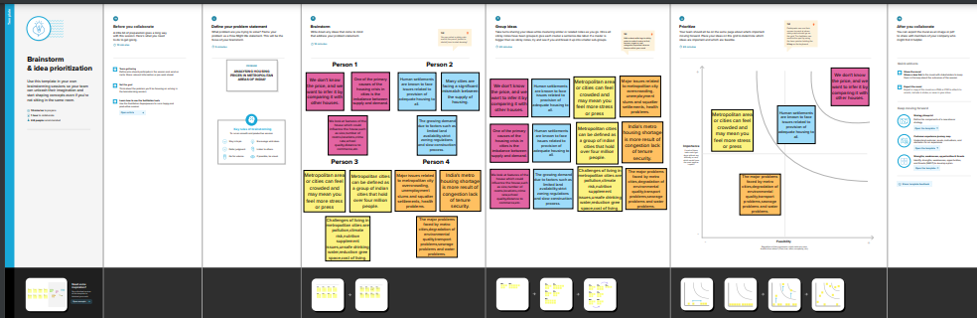
2.2 IDEATION & BRAINSTROMING MAP

Slide 7
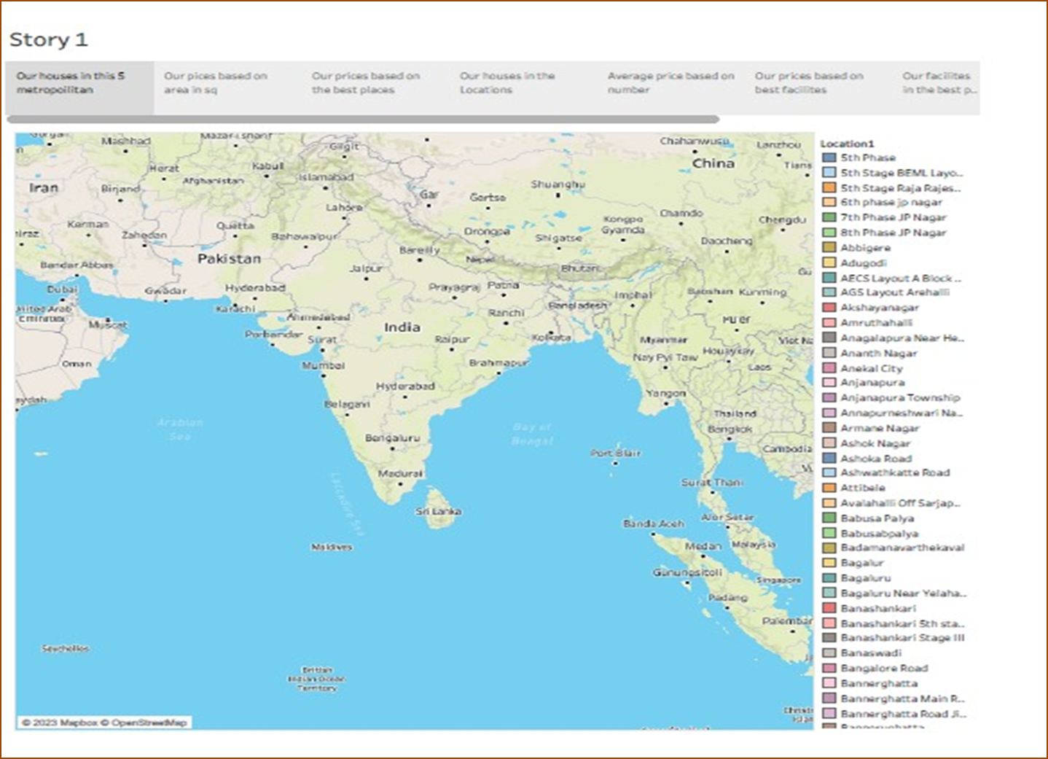
RESULT
HOUSING PRICES IN METROPOLITAN AREAS OF INDIA

Slide 8
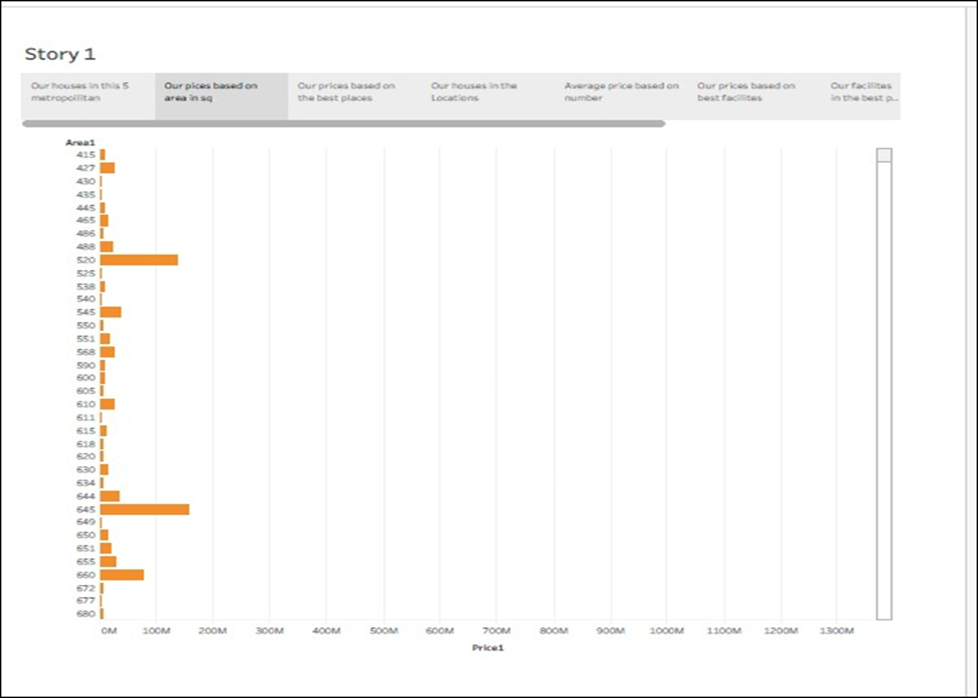

Slide 9
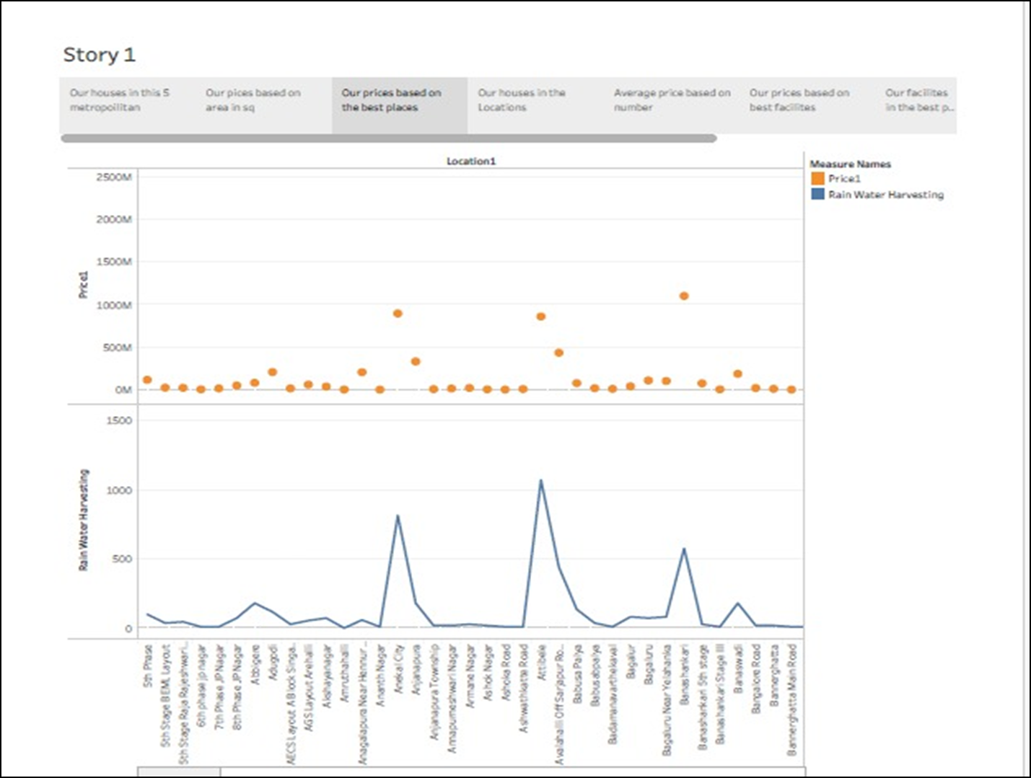

Slide 10
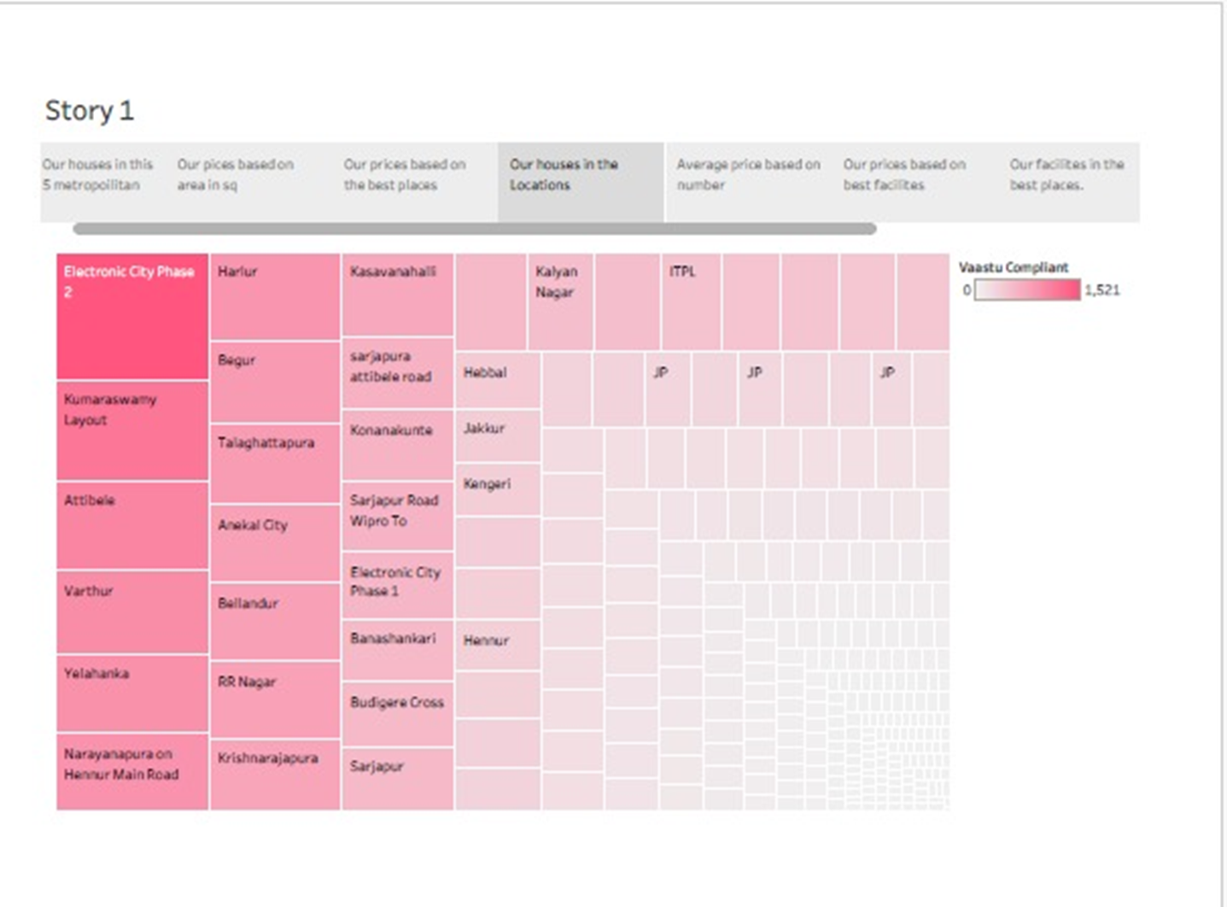

Slide 11
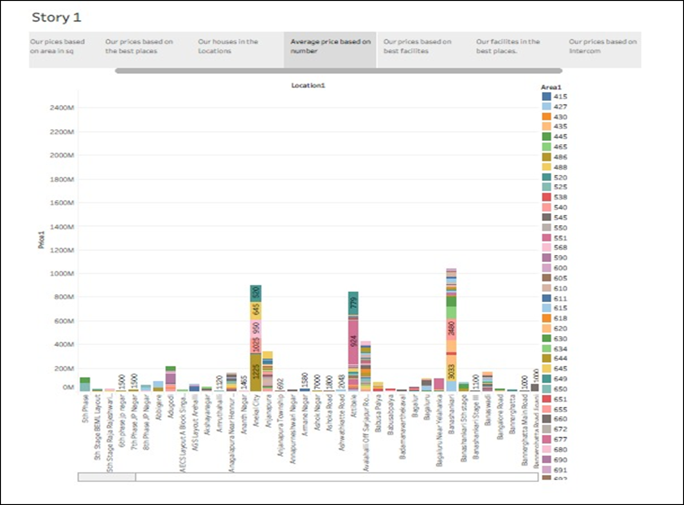

Slide 12
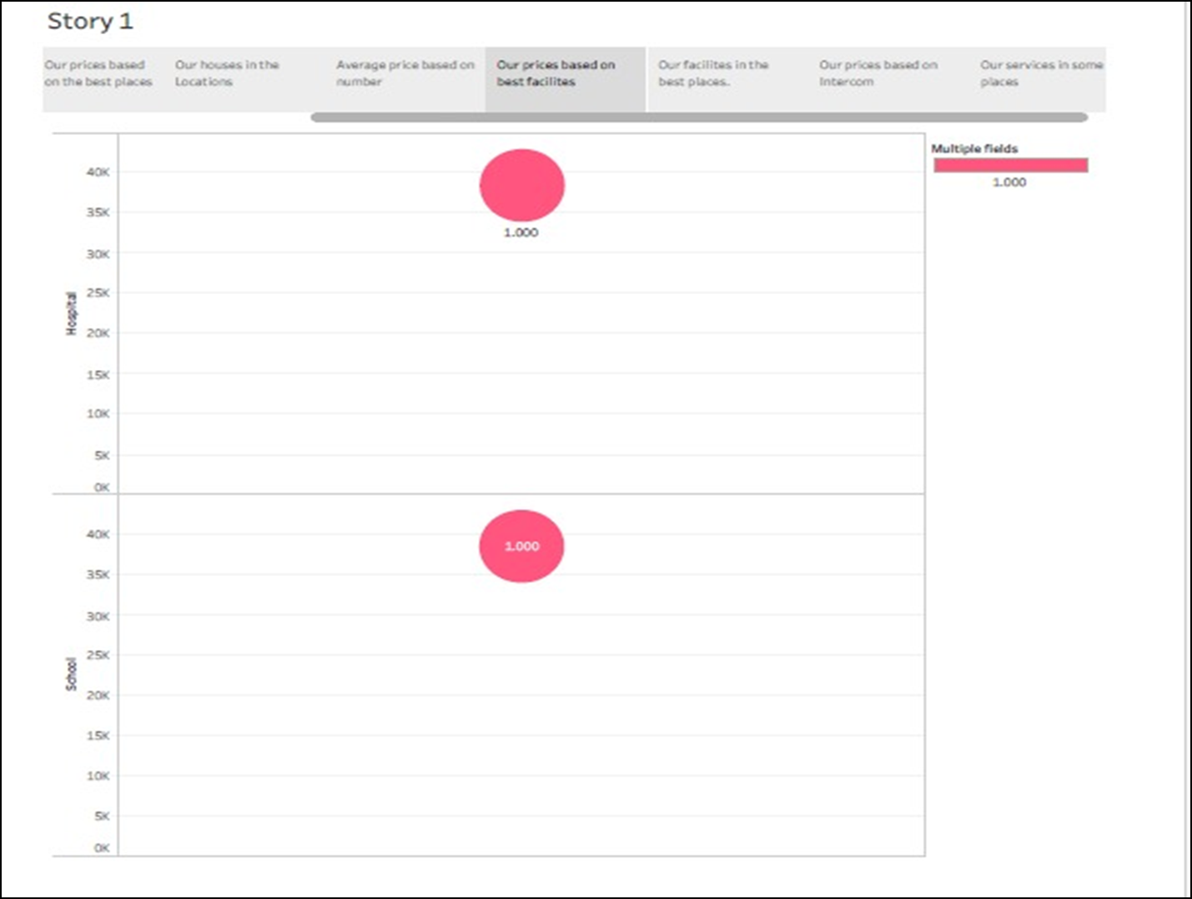

Slide 13
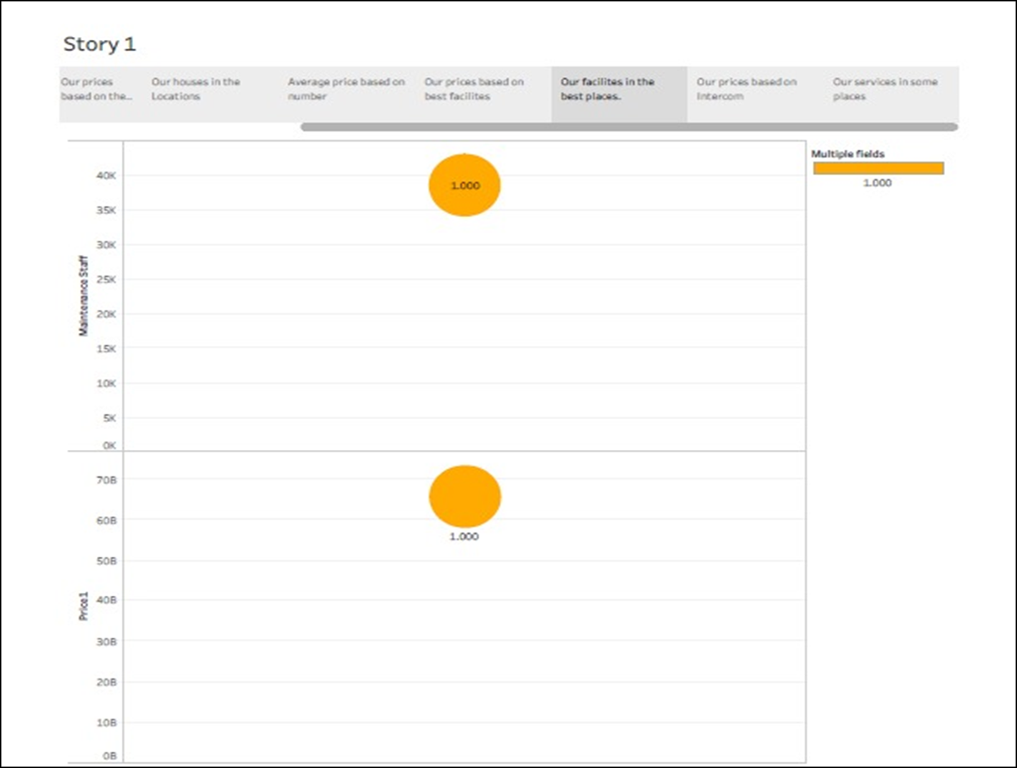

Slide 14
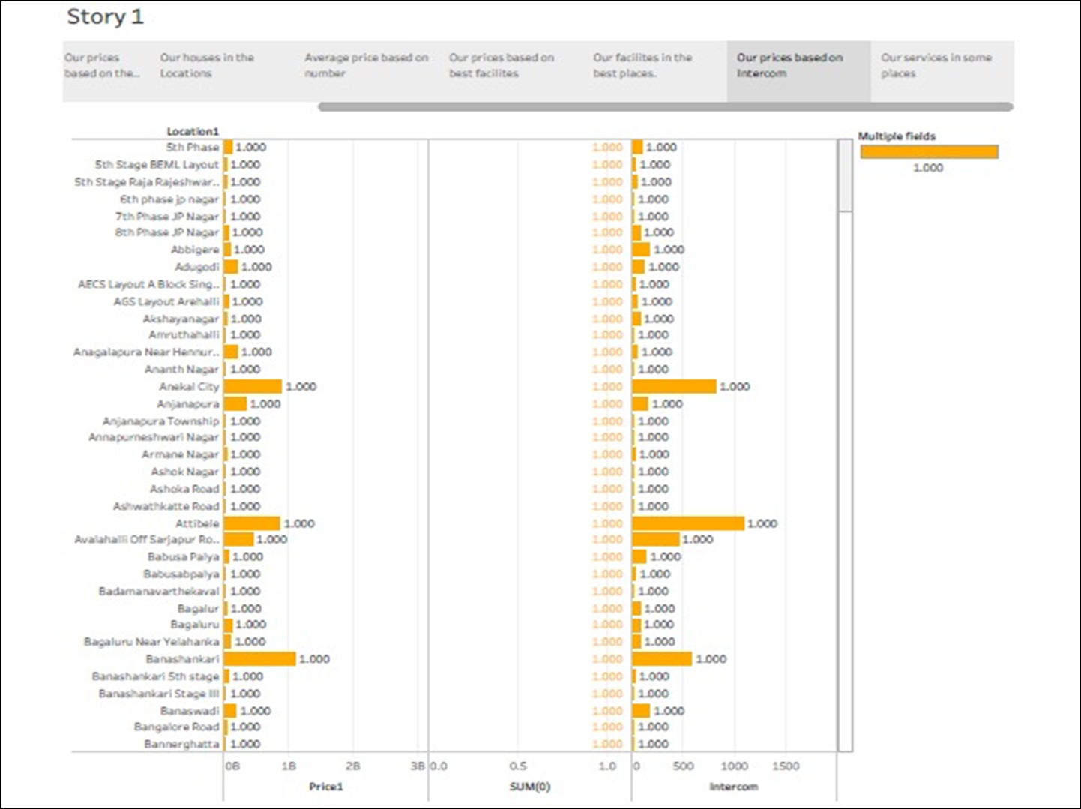

Slide 15
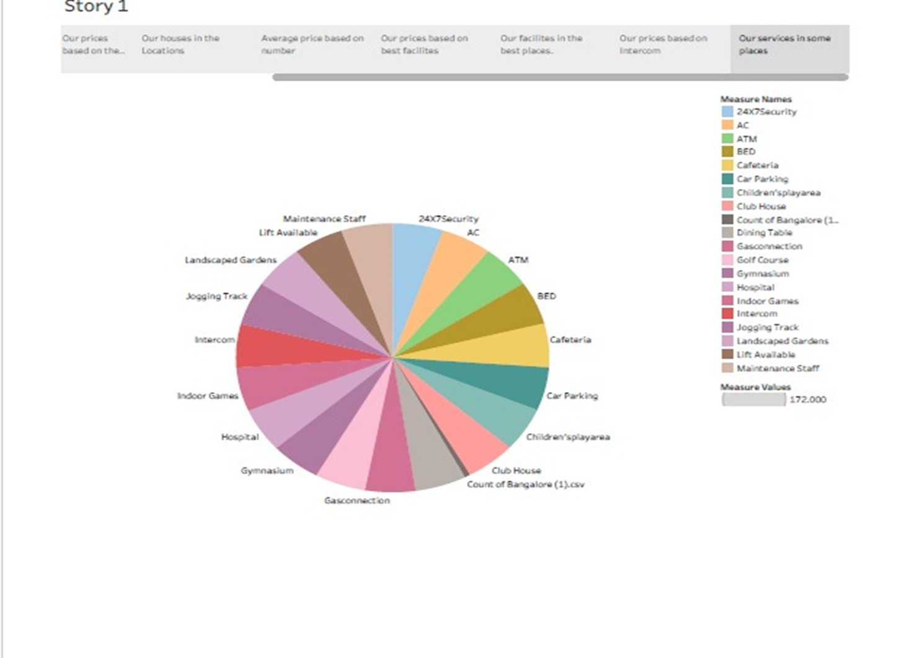

Slide 16
ADVANTAGES & DISADVANTAGES
ADVANTAGES
Transportation Advertisement.
Various Entertainment Options Advertisement.
Places to eat and shop .some experiences that areas available in smaller towns can be found in urban places.
Upgraded infrastructure.
Networking.
Medical Assistance and care.
Best Possible Comfort.
DISADVANTAGES
If you live alone , owning a house may not be in your best interest. Houses require high maintenances fees. When you face issues like plumbing and air conditioning, it will be up to you. Houses cost more to maintain than apartments.

Slide 17
Applications of Housing PRICES IN METROPOLITAN ARES OF INDIA
House price prediction in Metropolitan area in India is a valuable solution for potential home buyers.
By leveraging historical sales data, property details a predictive model can accurately estimate house prices.
Integration capability data privacy and cost effectiveness are also important considerations.

Slide 18
CONCLUSION
The challenge facing the world today is to minimize the negative effects and build the benefits.
Infrastructure needs to be improved.
Opportunities should be created within rural areas to prevent migration to cities.

Slide 19
FUTURE SCOPE
Property prices in India are expected to increase 7.5% on a pan-India basis this year, the fastest growth in five years, according to a Reuters poll of property analysts. Average house prices were forecast to rise 6% next year and in 2024.

Slide 20

THANK YOU

